Slide 1
Introduction to Parallel Computing
Reffered From:
To accompany the text ``Introduction to Parallel Computing'',
Addison Wesley, 2003.

Slide 2
Topic Overview
Motivating Parallelism
Scope of Parallel Computing Applications
Types of parallelism

Slide 3
Introduction to Parallel
Computing
A parallel computer is a “Collection of processing
elements that communicate and co-operate to solve large
problems fast”.
“Processing of multiple tasks simultaneous on
multiple processor is called parallel processing".

Slide 4
Parallel computing is a type of computation in which many calculations or the execution of processes are carried out simultaneously.
Large problems can often be divided into smaller ones, which can then be solved at the same time.

Slide 5
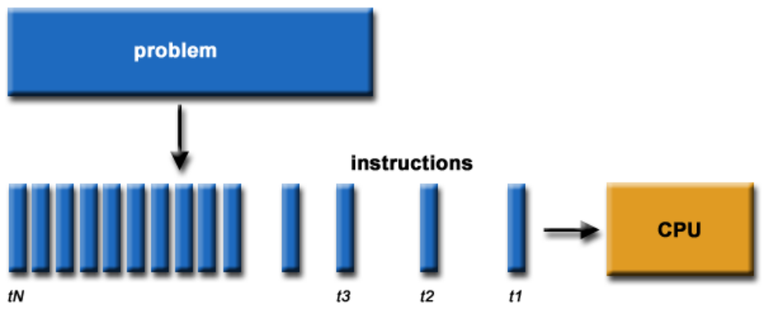
What is Parallel Computing?
Traditionally, software has been written for serial computation:
To be run on a single computer having a single Central Processing Unit (CPU)

Slide 6
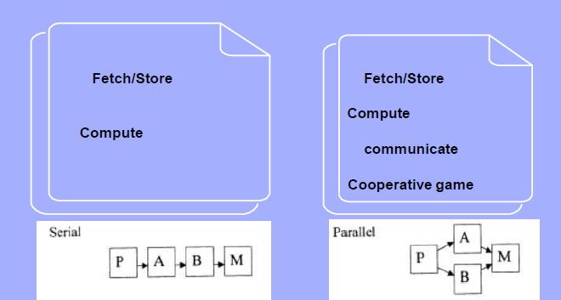
Serial Vs Parallel Computing

Slide 7
Avantages of Parallel Computing
It saves time and money as many resources working
together will reduce the time and cut potential costs.
It can be impractical to solve larger problems on Serial
Computing.
It can take advantage of non-local resources when the
local resources are finite.
Serial Computing ‘wastes’ the potential computing
power, thus Parallel Computing makes better work of hardware.

Slide 8
Parallel Computing: Resources​
The compute resources can include: ​
A single computer with multiple processors; ​
A single computer with (multiple) processor(s) and some specialized computer resources (GPU, FPGA …)​
An arbitrary number of computers connected by a network; ​
A combination of both. ​

Slide 9
Parallel Computing: The computational problem
The computational problem usually demonstrates characteristics such as the ability to be: ​
Broken apart into discrete pieces of work that can be solved simultaneously; ​
Execute multiple program instructions at any moment in time; ​
Solved in less time with multiple compute resources than with a single compute resource. ​

Slide 10
Parallel Computing: what for?
Parallel computing is an evolution of serial computing that attempts to emulate what has always been the state of affairs in the natural world: many complex, interrelated events happening at the same time, yet within a sequence.​
Some examples: ​
Planetary and galactic orbits ​
Weather and ocean patterns ​
Tectonic plate drift ​
Rush hour traffic in Paris ​

Slide 11
Parallel Computing: what for?
Today, commercial applications are providing an equal or greater driving force in the development of faster computers. These applications require the processing of large amounts of data in sophisticated ways. Example applications include: ​
parallel databases, data mining ,oil exploration ​
web search engines, web based business services ​
computer-aided diagnosis in medicine ​
management of national and multi-national corporations ​
​
Ultimately, parallel computing is an attempt to maximize the infinite but seemingly scarce commodity called time. ​

Slide 12
Why Parallel Computing? (1)​
This is a legitime question! Parallel computing is complex on any aspect!​
​
The primary reasons for using parallel computing: ​
Save time - wall clock time ​
Solve larger problems ​
Provide concurrency (do multiple things at the same time)

Slide 13
Why Parallel Computing? (2)​
Other reasons might include: ​
Taking advantage of non-local resources - using available compute resources on a wide area network, or even the Internet when local compute resources are scarce. ​
Cost savings - using multiple "cheap" computing resources instead of paying for time on a supercomputer. ​
Overcoming memory constraints - single computers have very finite memory resources. For large problems, using the memories of multiple computers may overcome this obstacle.

Slide 14
Limitations of Serial Computing​
Limits to serial computing - both physical and practical reasons pose significant constraints to simply building ever faster serial computers.​
Transmission speeds - the speed of a serial computer is directly dependent upon how fast data can move through hardware. Absolute limits are the speed of light (30 cm/nanosecond) and the transmission limit of copper wire (9 cm/nanosecond). Increasing speeds necessitate increasing proximity of processing elements. ​
Limits to miniaturization - processor technology is allowing an increasing number of transistors to be placed on a chip. However, even with molecular or atomic-level components, a limit will be reached on how small components can be. ​
Economic limitations - it is increasingly expensive to make a single processor faster. Using a larger number of moderately fast commodity processors to achieve the same (or better) performance is less expensive.

Slide 15
The future​
during the past 10 years, the trends indicated by ever faster networks, distributed systems, and multi-processor computer architectures (even at the desktop level) clearly show that parallelism is the future of computing.​
It will be multi-forms, mixing general purpose solutions (your PC…) and very speciliazed solutions as IBM Cells, ClearSpeed, GPGPU from NVidia …

Slide 16
Who and What? (1)​
Top500.org provides statistics on parallel computing users - the charts below are just a sample. Some things to note: ​
Sectors may overlap - for example, research may be classified research. Respondents have to choose between the two. ​
"Not Specified" is by far the largest application - probably means multiple applications.

Slide 17
Motivating Parallelism
The role of parallelism in accelerating computing speeds has been recognized for several decades.
Its role in providing multiplicity of datapaths and increased access to storage elements has been significant in commercial applications.
The scalable performance and lower cost of parallel platforms is reflected in the wide variety of applications.

Slide 18
Motivating Parallelism
Developing parallel hardware and software has traditionally been time and effort intensive.
If one is to view this in the context of rapidly improving uniprocessor speeds, one is tempted to question the need for parallel computing.
There are some unmistakable trends in hardware design, which indicate that uniprocessor (or implicitly parallel) architectures may not be able to sustain the rate of realizable performance increments in the future.
This is the result of a number of fundamental physical and computational limitations.
The emergence of standardized parallel programming environments, libraries, and hardware have significantly reduced time to (parallel) solution.

Slide 19
Motivating Parallelism
The Computational Speed Argument: For some
applications, this is the only means of achieving needed performance.
The Memory/Disk Speed Argument: For some other
applications, the needed I/O throughput can be provided only by a collection of nodes.
The Data Communication Argument: In yet other applications, the distributed nature of data implies that it is unreasonable to collect data to process it at a single location.

Slide 20
In short, motivation of parallel computing are :
1. Overcome limits to serial computing
2. Limits to increase transistor density
3. Limits to data transmission speed
4. Faster turn-around time
5. Solve larger problems

Slide 21
The Computational Power Argument
Moore's law states [1965]:
``The complexity for minimum component costs has increased at a rate of roughly a factor of two per year. Certainly over the short term this rate can be expected to continue, if not to increase. Over the longer term, the rate of increase is a bit more uncertain, although there is no reason to believe it will not remain nearly constant for at least 10 years. That means by 1975, the number of components per integrated circuit for minimum cost will be 65,000.''

Slide 22
The Computational Power Argument
Moore attributed this doubling rate to exponential behavior of die sizes, finer minimum dimensions, and ``circuit and device cleverness''.
In 1975, he revised this law as follows:
``There is no room left to squeeze anything out by being clever. Going forward from here we have to depend on the two size factors - bigger dies and finer dimensions.''
He revised his rate of circuit complexity doubling to 18 months and projected from 1975 onwards at this reduced rate.

Slide 23
The Computational Power Argument
If one is to buy into Moore's law, the question still remains - how does one translate transistors into useful OPS (operations per second)?
The logical recourse is to rely on parallelism, both implicit and explicit.
Most serial (or seemingly serial) processors rely extensively on implicit parallelism.
We focus in this class, for the most part, on explicit parallelism.

Slide 24
The Memory/Disk Speed Argument
While clock rates of high-end processors have increased at roughly 40% per year over the past decade, DRAM access times have only improved at the rate of roughly 10% per year over this interval.
This mismatch in speeds causes significant performance bottlenecks.
Parallel platforms provide increased bandwidth to the memory system.
Parallel platforms also provide higher aggregate caches.
Principles of locality of data reference and bulk access, which guide parallel algorithm design also apply to memory optimization.
Some of the fastest growing applications of parallel computing utilize not their raw computational speed, rather their ability to pump data to memory and disk faster.

Slide 25
The Data Communication Argument
As the network evolves, the vision of the Internet as one large computing platform has emerged.
This view is exploited by applications such as SETI@home and Folding@home.
In many other applications (typically databases and data mining) the volume of data is such that they cannot be moved.
Any analyses on this data must be performed over the network using parallel techniques.

Slide 26
Scope of Parallel Computing
Parallel computing has great impact on wide range of
applications.
Commercial (industry, automation)
Scientific (research)
Turn around time should be minimum (data mining, disk)
High performance (clustering, image processing)
Resource management (online exam, remote operation)
Load balancing (add or remove resource)
Dynamic library (e.g. update or upgrade)
Minimum network congestion and latency

Slide 27
Scope of Parallel Computing Applications
Parallelism finds applications in very diverse application domains for different motivating reasons.
These range from improved application performance to cost considerations.

Slide 28
Applications in Engineering and Design
Design of airfoils (optimizing lift, drag, stability), internal combustion engines (optimizing charge distribution, burn), high-speed circuits (layouts for delays and capacitive and inductive effects), and structures (optimizing structural integrity, design parameters, cost, etc.).
Design and simulation of micro- and nano-scale systems.
Process optimization, operations research.

Slide 29
Scientific Applications
Functional and structural characterization of genes and proteins.
Advances in computational physics and chemistry have explored new materials, understanding of chemical pathways, and more efficient processes.
Applications in astrophysics have explored the evolution of galaxies, thermonuclear processes, and the analysis of extremely large datasets from telescopes.
Weather modeling, mineral prospecting, flood prediction, etc., are other important applications.
Bioinformatics and astrophysics also present some of the most challenging problems with respect to analyzing extremely large datasets.

Slide 30
Commercial Applications
Some of the largest parallel computers power the wall street!
Data mining and analysis for optimizing business and marketing decisions.
Large scale servers (mail and web servers) are often implemented using parallel platforms.
Applications such as information retrieval and search are typically powered by large clusters.

Slide 31
Applications in Computer Systems
Network intrusion detection, cryptography, multiparty computations are some of the core users of parallel computing techniques.
Embedded systems increasingly rely on distributed control algorithms.
A modern automobile consists of tens of processors communicating to perform complex tasks for optimizing handling and performance.
Conventional structured peer-to-peer networks impose overlay networks and utilize algorithms directly from parallel computing.

Slide 32
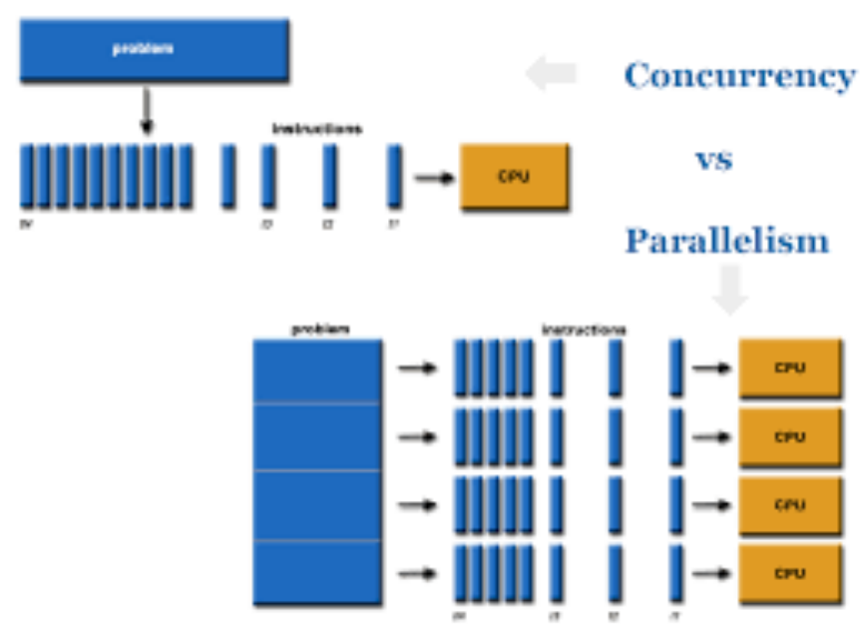
Concurrency Vs Parallelism
Concurrency is when two tasks can start, run, and
complete in overlapping time periods.
The term Parallelism refers to techniques to make
programs faster by performing several computations
at the same time.

Slide 33
Types of Parallelism
1. Instruction Level Parallelism
2. Thread or Task Level Parallelism
3. Data Level Parallelism
4. Bit Level Parallism

Slide 34
Instruction-level parallelism (ILP)
Instruction-level parallelism means the simultaneous
execution of multiple instructions from a program.
While pipelining is a form of ILP, we must exploit it to
achieve parallel execution of the instructions in the
instruction stream.
Example
for (i=1; i<=100; i= i+1)
y[i] = y[i] + x[i];
This is a parallel loop. Every iteration of the loop can overlap with any other iteration, although within each loop iteration there is little opportunity for overlap.

Slide 35
Thread-level or task-level parallelism
(TLP)
Task Parallelism means concurrent execution of the
different task on multiple computing cores
Consider an example of task parallelism might involve
two threads, each performing a unique statistical
operation on the array of elements. Again The threads are operating in parallel on separate computing cores, but each is performing a unique operation.

Slide 36
Data level parallelism (DLP)
Data Parallelism means concurrent execution of the same task on each multiple computing core.
Let’s take an example, summing the contents of an array of size N. For a single-core system, one thread would simply sum the elements [0] . . . [N − 1]. For a dual-core system, however, thread A, running on core 0, could sum the elements [0] . . . [N/2 − 1] and while thread B, running on core 1, could sum the elements [N/2] . . . [N − 1]. So the Two threads would be running in parallel on separate computing cores.

Slide 37
Bit-level parallelism
Bit-level parallelism is a form of parallel computing based on increasing processor word size, depending on very-large-scale integration (VLSI) technology. Enhancements in computers designs were done by
increasing bit-level parallelisms.
(For e.g., consider a case where an 8-bit processor must add two 16-bit integers. The processor must first add the 8 lower-order bits from each integer, then add the 8 higher-order bits, requiring two instructions to complete a single operation. A 16-bit processor would be able to

